Slide 1
Handling Text Data
Data Science for Beginners, Session 7
Notes:
This session looks at a special type of data: text, as in the freeform sentences that people write or speak.

Slide 2
Session 6 (Machine Learning) recap
Defining machine learning
The Scikit-Learn library
Machine learning algorithms
Choosing an algorithm
Measuring algorithm performance
Notes:
Here’s what we did in the last session. Some of this (e.g. classification) will be useful in this session.

Slide 3
Session 7: your 5-7 things
Get familiar with text processing
Get familiar with text data
Read text data
Classify text data
Analyse text data
Notes:
And here’s what this session covers. Text processing is a huge topic, so we’re just getting familiar with some of the key ideas.

Slide 4
Text processing
Information retrieval
  Search
  Named entity recognition
Learning
  Classification
  Clustering
  Topic identification/ topic following
  Sentiment analysis
  Network analysis (words, people etc)
Comprehension
  Natural language processing
  Translation
  Truthfulness (e.g. verifying phemes)
Notes:
Topic following: includes tracking things like hate speech (iHub Nairobi has done a lot of work on this topic)
Verification: the Pheme project (http://www.pheme.eu/) is working on automatically tracking the veracity of stories.

Slide 5
Reading Text Data
Notes:
First we need to read in text-based data, and process it ready for algorithms and visualisations.

Slide 6
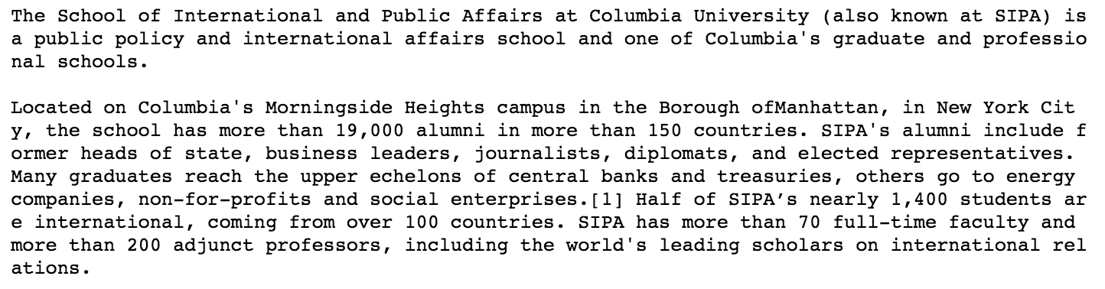
Text Data Sources
Messages (tweets, emails, sms messages...)
Document text (reports, blogposts, website text…)
Audio (via speech-to-text processing)
Images (via OCR)
Notes:
We’re looking at two pieces of data today: the Wikipedia entry for SIPA (copied here), and a set of tweets about the #migrantcrisis, grabbed from the Twitter API by using notebook 3.1.

Slide 7
Get your raw text data
fsipa = open('sipatext.txt', 'r')
sipatext = fsipa.read()
fsipa.close()
print(sipatext)
Notes:
Here’s the code to read in a raw text file.
If you want to work on pdf data, you’ll have to scrape it first (see the earlier session on this);
For microsoft word documents, try the python-docx library.
For speech recognition in python, try https://pypi.python.org/pypi/SpeechRecognition/ or speech http://code.activestate.com/recipes/579115-recognizing-speech-speech-to-text-with-the-python-/
For OCR, try the pytesseract library
For anything else, you’ll have to search for a library: http://www.file-extensions.org/filetype/extension/name/text-files
can help with text file extension names.

Slide 8
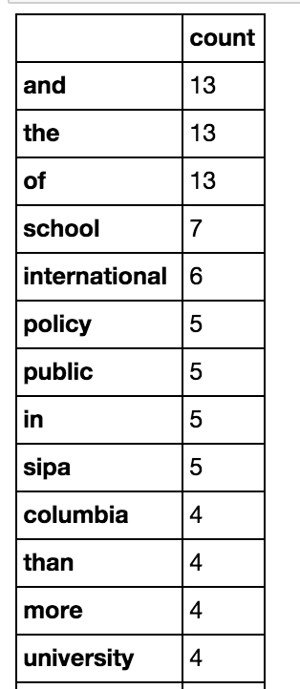
Counting: Bags of Words
from sklearn.feature_extraction.text import CountVectorizer
count_vect = CountVectorizer()
word_counts = count_vect.fit_transform([sipatext])
print('{}'.format(word_counts))
print('{}'.format(count_vect.vocabulary_))
Notes:
It’s possible to process text as sentences, but it’s more useful to separate it into individual words. The most common way to compare text from documents, tweets etc is to create a Bag of Words: a list of all the words in a text, and how many times each of them appears in it.
The scikit-learn library has some powerful text processing functions, including this one (CountVectorizer) to separate text into words.

Slide 9
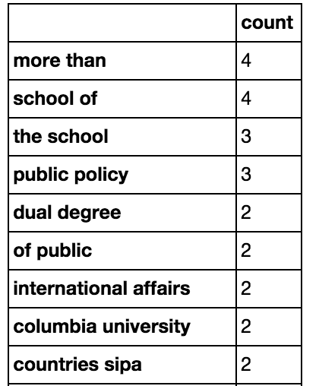
Counting sets of words: N-Grams
Pairs (or triples, 4s etc) of words
Also: pairs etc of characters, e.g. [‘mor’, ‘ore’, ‘re ‘, ‘e t’, ‘ th’, ‘tha’, ‘han’]
Know your Ns:
  ‘Unigram’ == 1-gram
  ‘Bigram’ == 2-gram
  ‘Trigram’ == 3-gram
count_vectn = CountVectorizer(ngram_range =(2, 2))
Notes:
Another approach is to look not at individual words, but at sets of characters (unigram=1 character, bigram=2 characters; trigram=3 characters, n-gram=n characters) or words (also known as word n-grams). CountVectoriser has a parameter, ngram_range, that tells it which sets of words to use (ngram_range=(x,y) will give you all the n-grams from x to y, e.g. (1,2) will give you unigrams and bigrams together).
NB The same word (n-gram) is used for both characters and words, so if someone says n-gram, check which algorithm they’re using.

Slide 10
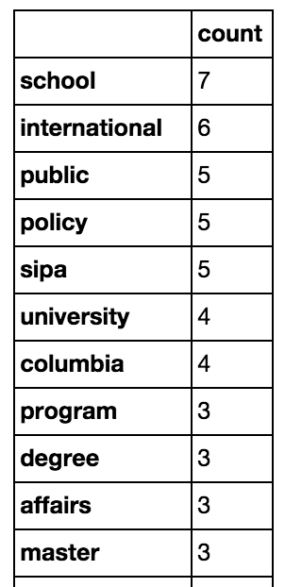
Stopwords
count_vect2 = CountVectorizer(stop_words='english')
word_counts2 = count_vect2.fit_transform([sipatext])
Notes:
Stopwords are common words (“the”, “a”, “and”) that don’t add to meaning, and might confuse outputs. The CountVectorizer parameter stop_words tells it which set of stopwords to remove (e.g. English, French etc).

Slide 11
Term Frequencies
TF: Term Frequency:
  word count / (number of words in this document)
  “How important (0 to 1) is this word to this document”?
IDF: Inverse Document Frequency
  1 / (number of documents this word appears in)
  “How common is this word in this corpus”?
TFIDF:
  TF * IDF
Notes:
From http://stevenloria.com/finding-important-words-in-a-document-using-tf-idf/:
If a word appears frequently in a document, it's important. Give the word a high score.
But if a word appears in many documents, it's not a unique identifier. Give the word a low score.

Slide 12
Machine Learning with Text Data
Notes:
If you’re processing text, machine learning algorithms can be surprisingly useful (if you’ve ever tried tagging thousands of tweets, you’ve learnt this lesson the hard way). Here are some examples.

Slide 13
Classifying Text
Words are a valid input to machine learning algorithms
In this example, we’re using:
Newsgroup emails as samples (‘rows’ in our input)
Words in each email as features (‘columns’)
Newsgroup ids as targets
Notes:
This example comes from the scikit-learn training pages. We’re going to walk through it slowly, and explain what’s happening in each step.

Slide 14
The 20newsgroups dataset
from sklearn.datasets import fetch_20newsgroups
cats = ['alt.atheism', 'soc.religion.christian', 'comp.graphics', 'sci.med']
twenty_train = fetch_20newsgroups( subset='train', categories=cats)
twenty_test = fetch_20newsgroups(subset='test', categories=cats)
Notes:
One of Scikit-learn’s example datasets is all the text from a set of early newsgroup posts. We’re going to use that, but restrict the ones that read to just 4 subjects: atehism, christianity, computer graphics and medicine. Here’s how to get that dataset.

Slide 15
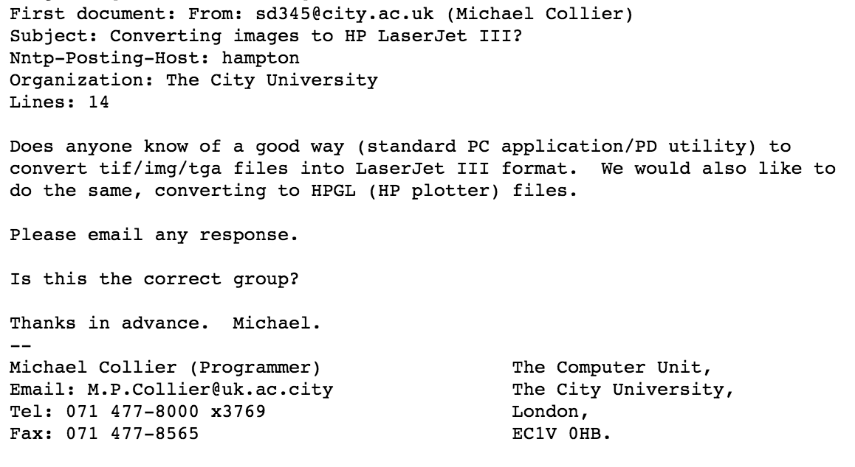
Example email
Notes:
Here’s the first post (email) in the dataset. It appears to be about computer graphics.

Slide 16
Convert words to TFIDF scores
from sklearn.feature_extraction.text import CountVectorizer
from sklearn.feature_extraction.text import TfidfTransformer
count_vect = CountVectorizer()
X_train_counts = count_vect.fit_transform(twenty_train.data)
tfidf_transformer = TfidfTransformer(use_idf=True)
X_train_tfidf = tfidf_transformer.fit_transform(X_train_counts)
Notes:
We first create a bag of words for every post in our dataset.
We don’t want words to be weighted as more important than they should be (e.g. we want to pay attention to rare words in the dataset), so we use Scikit-learn’s TfidfTransformer function to convert this to a set of tfidf scores.

Slide 17
Fit your model to the data
from sklearn.naive_bayes import MultinomialNB
nb_classifier = MultinomialNB().fit(X_train_tfidf, twenty_train.target)
Notes:
Then we use the newsgroup labels (atheism etc) as classes, to learn the association between sets of words in posts and these labels. We’re using a naïve Bayes algorithm as a classifier because although it probably won’t give the most accurate results possible, it’s pretty hard to break.

Slide 18

Test your model
docs_test = ['God is love', 'OpenGL on the GPU is fast']
X_new_counts = count_vect.transform(docs_test)
X_new_tfidf = tfidf_transformer.transform(X_new_counts)
predicted = nb_classifier.predict(X_new_tfidf)
for doc, category in zip(docs_test, predicted):
print('{} => {}'.format(doc, twenty_train.target_names[category]))
Notes:
And then we feed the classifier two pieces of text that it hasn’t seen before, to see which classes it puts them in. Go on: try this with your own example text!

Slide 19
Text Clustering
We can also ‘cluster’ documents
The ‘distance’ function is based on the words they have in common
Common machine learning algorithms for text clustering include:
Latent Semantic Analysis
Latent Dirichlet Allocation
Notes:
Other machine learning algorithms can be used on text data: unsupervised clustering is often used to see which documents can be grouped together (e.g. into topics).

Slide 20
Text Analysis
Notes:
There are a bunch of other things that we can do with bags of words. Here are some of them.

Slide 21
Word colocation
Create a graph (network visualisation) of words that appear together in documents
Use network analysis (later session) to show which pairs of words are important in your documents

Slide 22
Sentiment analysis
Mark documents (e.g. tweets) as having positive or negative sentiment
Using machine learning
  Training set: sentences, with ‘positive’/’negative’ for each sentence
Using a sentiment dictionary
  Positive or negative ‘score’ for each emotive word
  Sentiment dictionaries can be used as machine learning algorithms ‘seeds’

Slide 23
Named Entity Recognition
Find the names of people, organisations, locations etc in text
Can use these to create social graphs (networks showing how people etc connect to each other) and find ‘hubs’, ‘connectors’ etc

Slide 24
Natural Language Processing
Notes:
Natural language processing goes beyond the bag of words, and attempts to create a logical model of each sentence. It’s also known as computational linguistics.

Slide 25
Natural Language Processing
Understanding the grammar and meaning of text
Useful for, e.g. translation between languages
Python library: NLTK

Slide 26
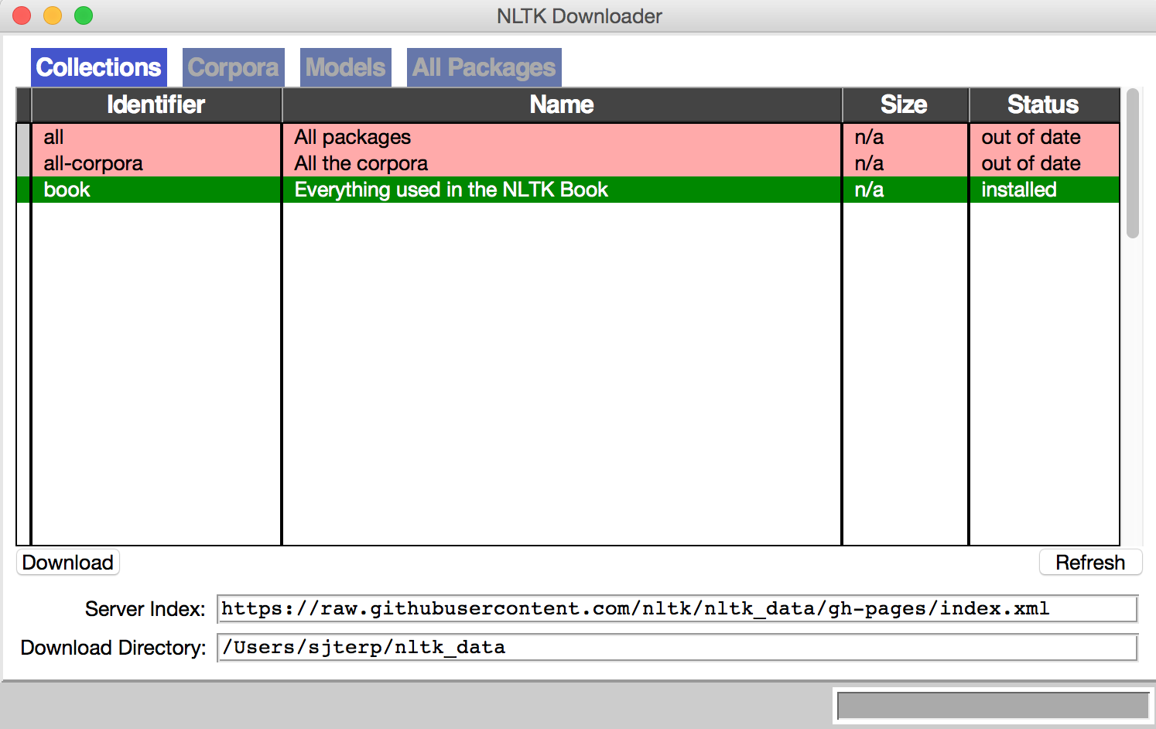
Getting started with NLTK
import nltk
nltk.download()
Notes:
You need to download a bunch of dictionaries etc before you can use the NLTK library. You do this with the nltk.download() command (you only need to do this once). NLTK.download() will create this pop-up box. Click on “book”, then “download” to get the standard set of files.

Slide 27
Get text ready for NLTK processing
from nltk import word_tokenize
from nltk.text import Text
fsipa = open('example_data/sipatext.txt', 'r')
sipatext = fsipa.read()
fsipa.close()
sipawords = word_tokenize(sipatext)
textlist = Text(sipawords)
Notes:
You still have to do some preprocessing. This is the set of commands to convert raw text into an input ready for NLTK’s algorithms.

Slide 28
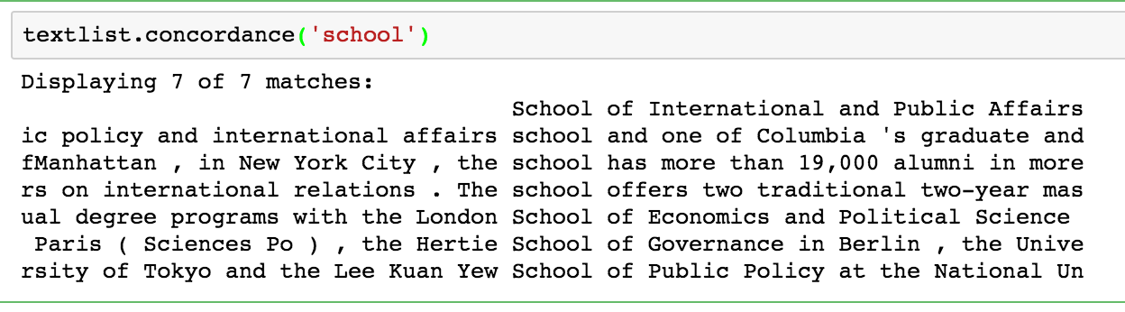
NLTK: concordance
textlist.concordance(‘school’)
textlist.similar('school')
textlist.common_contexts(['school', 'university'])
Notes:
Concordance shows you how words occur together, e.g. you can look at this context (above) or look for words used in similar context (textlist.common_contexts).

Slide 29
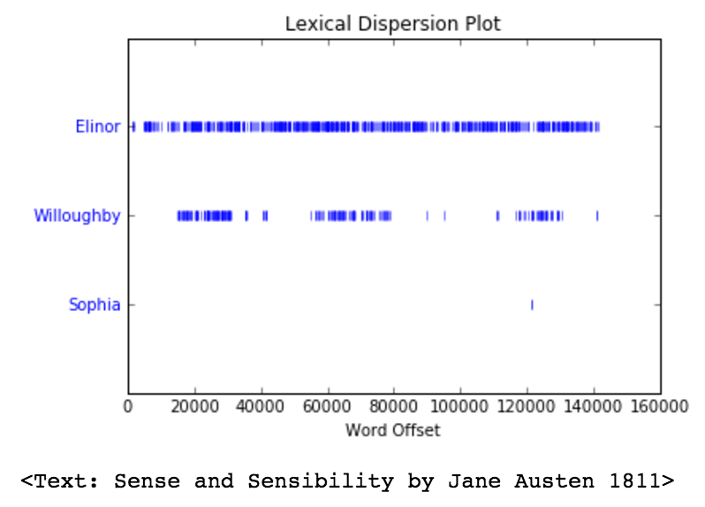
NLTK: word dispersion plots
from nltk.book import *
text2.dispersion_plot(['Elinor', 'Willoughby', 'Sophia'])
Notes:
Word dispersion plots are a useful way to see where specific words appear in a text. NLTK comes with a set of example texts, including Austen’s Sense and Sensibility, used here to show where three main characters are mentioned.

Slide 30
NLTK: Word Meanings
from nltk.corpus import wordnet as wn
word = 'class'
synset = wn.synsets(word)
print('Synset: {}\n'.format(synset))
for i in range(len(synset)):
print('Meaning {}: {} {}'.format(i, synset[i].lemma_names(), synset[i].definition()))
Notes:
NLTK also lets you look up the set of synsets: meanings for an individual word.

Slide 31
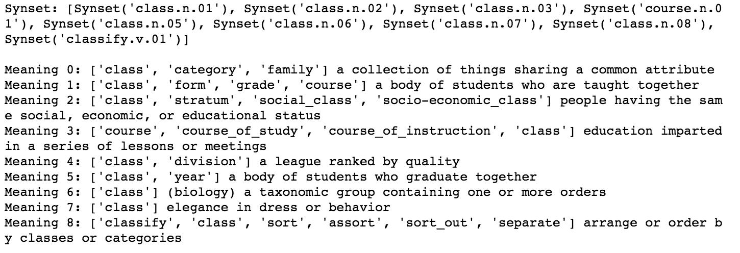
NLTK: Synsets
Notes:
Here is the synset for the word “class”.

Slide 32
NLTK: converting words into logic
from nltk import load_parser
parser = load_parser('grammars/book_grammars/simple-sem.fcfg', trace=0)
sentence = 'Angus gives a bone to every dog'
tokens = sentence.split()
for tree in parser.parse(tokens):
print(tree.label()['SEM'])
Notes:
And NLTK lets you convert sentences into logical statements that can be used in Artificial Intelligence programs.
More than you ever wanted to know about parsing sentences is here:
http://www.nltk.org/howto/featgram.html
Simple_sem is a simple grammar, just for teaching: its whole specification is at https://github.com/nltk/nltk_teach/blob/master/examples/grammars/book_grammars/simple-sem.fcfg

Slide 33
Exercises

Slide 34
Exercises
Try the code in the 7.x series notebooks

